Slide 1
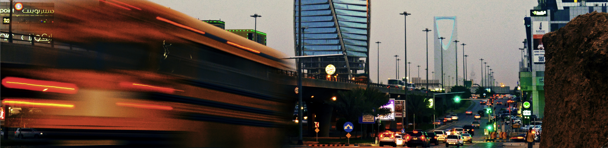
Twitter | Traffic
Does Twitter usage predict traffic in Riyadh?
Dennis Harvey & Brandon Peterson
MIT DUSP | Big Data, Visualization, and Society

Slide 2

| RIYADH, CONGESTION, AND THE TWITTER LINK
To what extent is Twitter an indicator of traffic congestion in Riyadh?
How does congestion change throughout the day for Riyadh’s road typologies?
69%
of drivers in Riyadh use their phones on the road.
24hr
jail time when caught using cell phones while driving.
Sources: http://www.arabnews.com/featured/news/893016, http://www.arabnews.com/motoring/news/881881

Slide 3

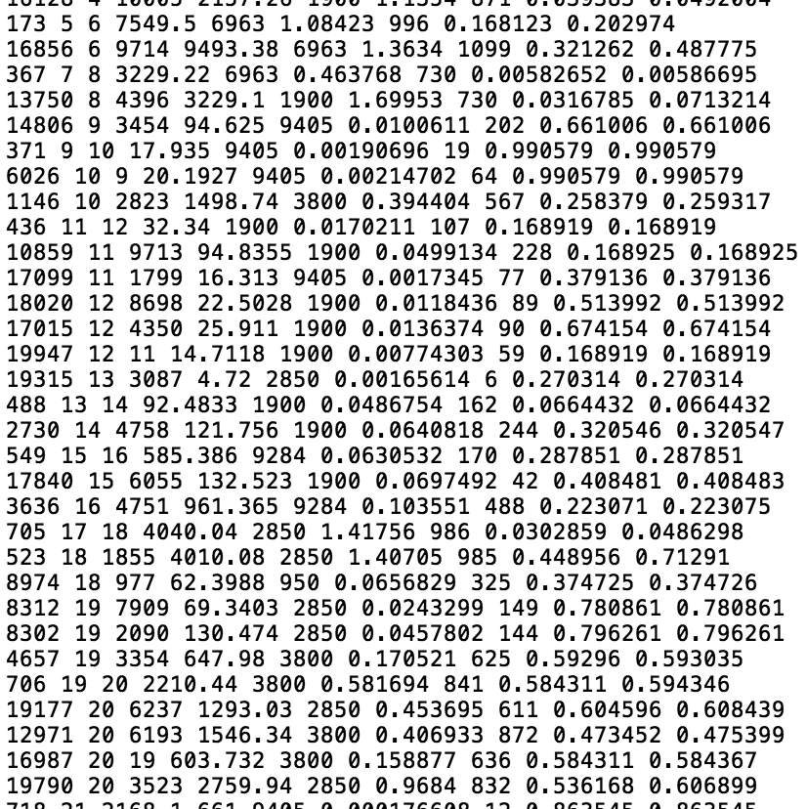
| DATA: NETWORKS, TWEETS, ROUTING
Riyadh Road Networks
(Shapefile + database)
Geolocated Tweets
(Scraped from Riyadh)
Riyadh Routing Results
(Congestion on edges)
+
+

Slide 4

| TWITTER DATA & CONGESTION
1
2
3
1. Map the tweets.
2. Assign tweets to road network basedon buffer.
3. Modify edge thickness based on congestion, and color based on tweets.

Slide 5
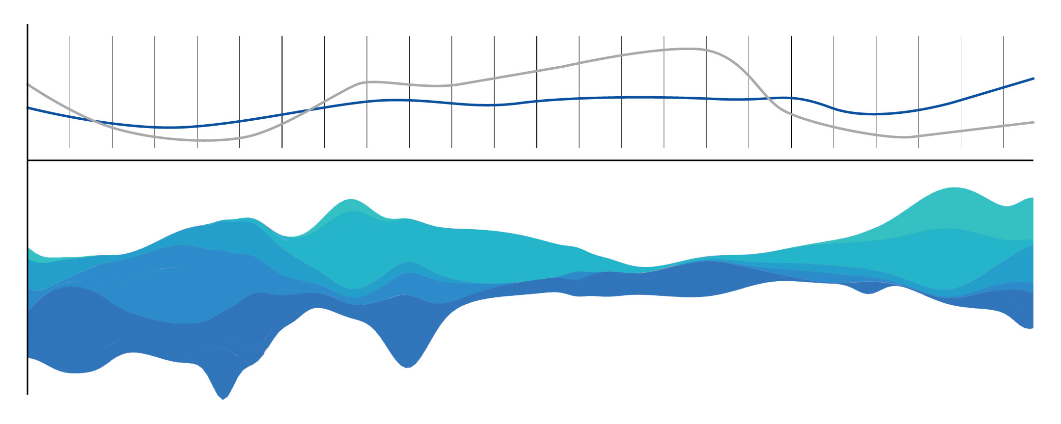
| ROAD TYPOLOGIES & CONGESTION
Top: Tweets v. Total Congestion | Bottom: Congestion by Typology
1. Freeways
2. Major arterials
THE
FOUR TYPES
OF STREET
TYPOLOGY
3. Minor arterials
4. Collectors

Slide 6
| TOOLS
| TIMELINE
| GROUP
Python, Twython
Rhino, Grasshopper (studies)
D3
ArcGIS (studies)
Mapbox
HTML Editor
3.31: Finish reviewing data, begin GIS, and
test visuals with Grasshopper.
4.07: Begin D3 coding and mapping.
4.14: D3 coding continued.
4.21: Begin Python visualizations.
4.28: Python visualizations continued.
5.05: Complete final visualizations.
5.12: Final Presentation.
Dennis Harvey
+ Grasshopper studies + visuals
+ Python visualizations
+ D3 coding
Brandon Peterson
+ Twitter data + GIS mapping
+ Python visualizations
+ D3 coding

